Slide 1
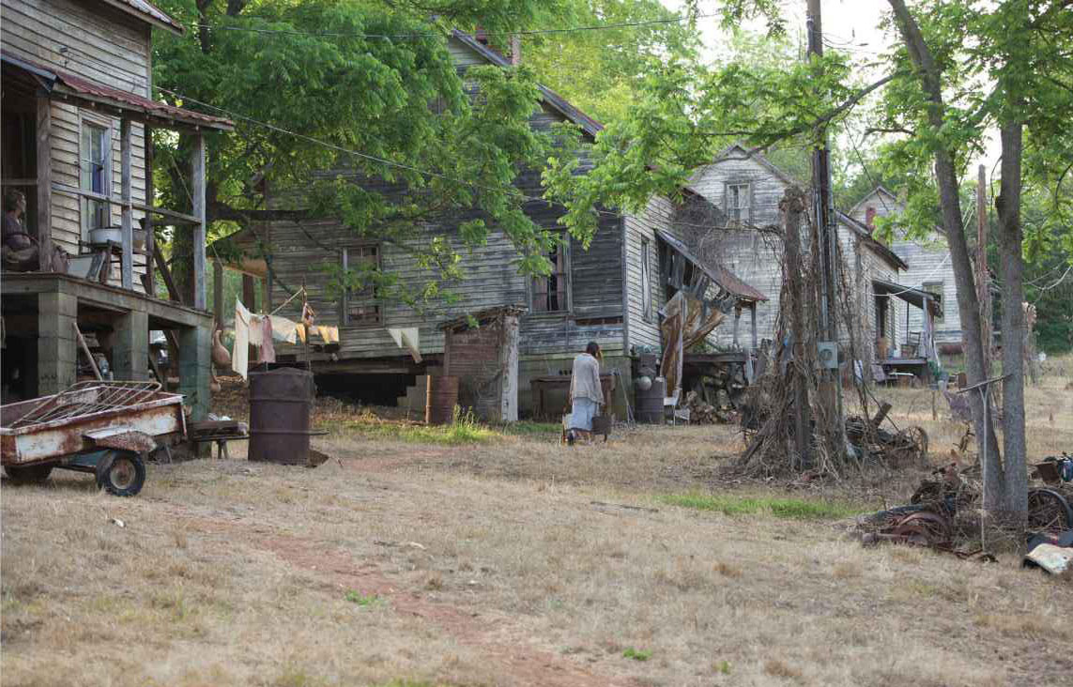
What is it like to live here?

Slide 2
L.O.
Select key information from a text to support inference (AF2/AF3)
S.C.
6b – All the key points are covered
6a – Explore different layers of meaning
7 – Insightful and precise use of quotes

Slide 3

Read Chapter 1 and 2.
What do we learn about District 12?
What are the people like?
What is the environment like?
What is society like?
Extension Task – How important do you think District 12 is in the wider society of Panem?

Slide 4
People
Environment
Society
Split into two sections – “________”
Remember that quotes shouldn’t be any more than 5/6 words!
(Level 7 – Precise use of quotes)

Slide 5
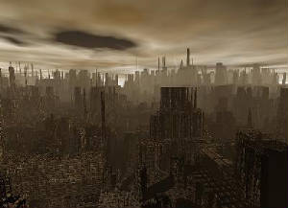
How does District 12 fit in with the conventions of dystopian society?

Slide 6
District 12 has many elements which fit in with the key conventions of dystopian fiction. For example, the freedom of the citizens is restricted by a ‘chain-link fence’ which surrounds the district. The government of Panem have set out clear guidelines of where they want citizens to go. The ‘fence’ could also imply that the citizens are caged in like prisoners, rather than being kept from going somewhere.
The writer goes on to tell us that this fence is ‘topped with barbed-wire’. This ‘barbed-wire’ reinforces the impression that this area is considered off limits. Furthermore, this implies that anyone who breaks the rules in this society are punished severely and in painful ways, an implication which is strengthened by the fact this fence is ‘electrified 24 hours a day’.

Slide 7
For example, the freedom of the citizens is restricted by a ‘chain-link fence’ which surrounds the district.
The writer goes on to tell us that this fence is ‘topped with barbed-wire’.
an implication which is strengthened by the fact this fence is ‘electrified 24 hours a day’.
These are called embedded quotes - which is a more sophisticated way of introducing quotes than saying ‘This is shown in the quote...’

Slide 8
• Propaganda is used to control the citizens of society.
• Information and independent thought are restricted.
• A figurehead or concept is worshipped by the citizens of the society.
• Citizens are perceived to be under constant surveillance.
• Citizens have a fear of the outside world.
• Citizens live in a dehumanized state.
• The natural world is banished and distrusted.
• Citizens conform to uniform expectations. Individuality and dissent are bad.
• The society is an illusion of a perfect utopian world.
Can you write a PEED paragraph to support one of the points above.
Include:
An introductory point
A quote of no more than 6 words as evidence (try to embed your quote!)
An explanation of what the quote tells us
Developed ideas which can include different layers of meaning or other quotes to support your point

Slide 9

Have they included:
An introductory point?
A quote of no more than 6 words as evidence? (Have they embedded their quote?)
An explanation of what the quote tells us?
Developed ideas which can include different layers of meaning or other quotes to support their point?

Slide 10
What is it like to live here?

